Slide 1
Assimilation of Point and/or Spatial Data
Bailian Chen
EES-16
08/06/2020

Slide 2
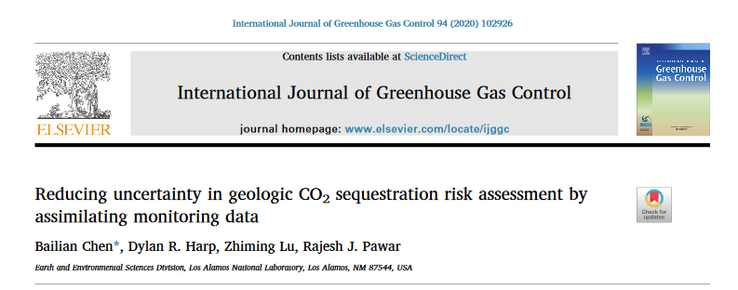
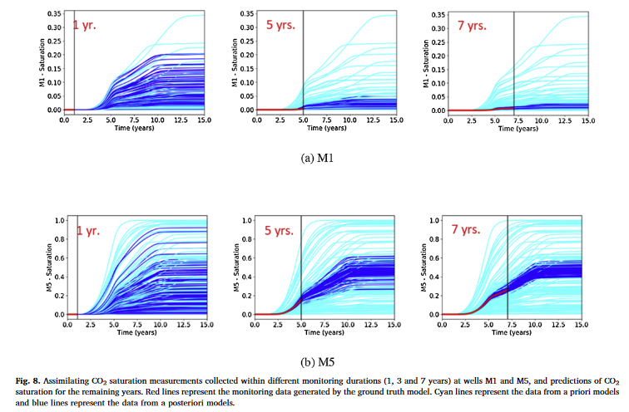
Recap: History matching point data
The variability in the predictions of CO₂ S. is reduced by assimilating monitoring data after different monitoring durations
The reduction in variability increases with increased monitoring data assimilation

Slide 3
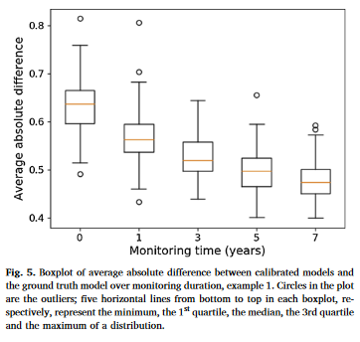
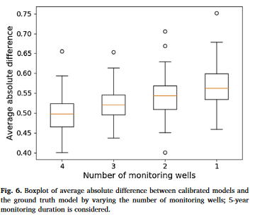
Recap: History matching point data

Slide 4
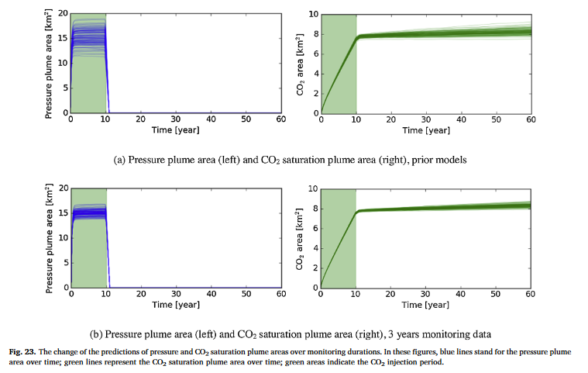
Recap: History matching point data

Slide 5
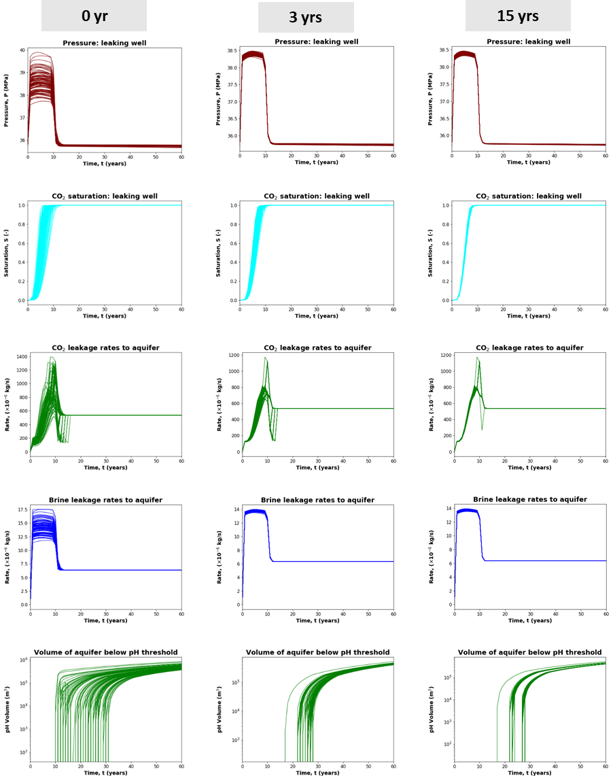

Recap: History matching point data
Uncertainty reduction in risk quantities based on assimilation of point data is significant.
Will spatial data (e.g., spatial CO₂ saturations from seismic) bring in additional benefits for uncertainty reduction?

Slide 6
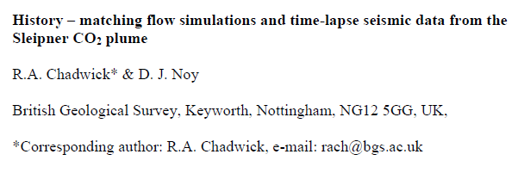
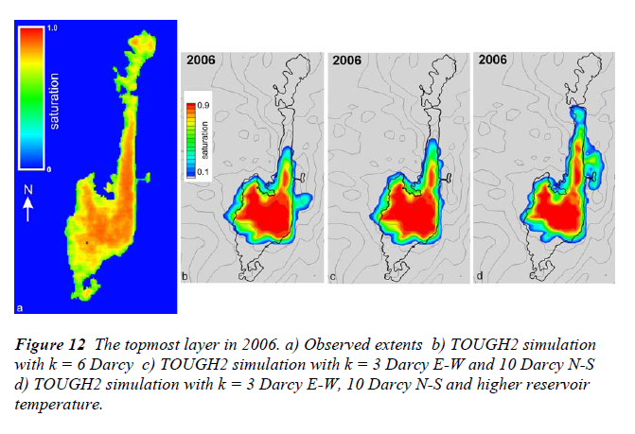
History matching CO₂ plume area (spatial data)
(Literature review)
Seismic data was converted to spatial CO₂ saturation data
Manual history matching!!!

Slide 7
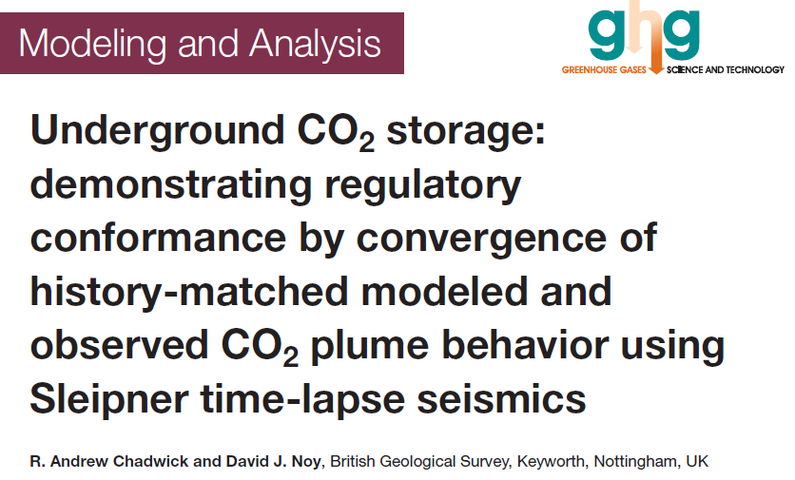
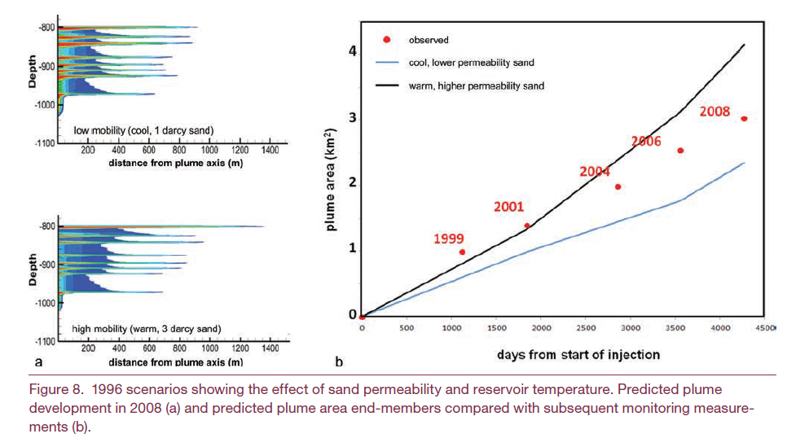
History matching CO₂ plume area (spatial data)
(Literature review)
Seismic data was converted to spatial CO₂ saturation data
Manual history matching!!!

Slide 8
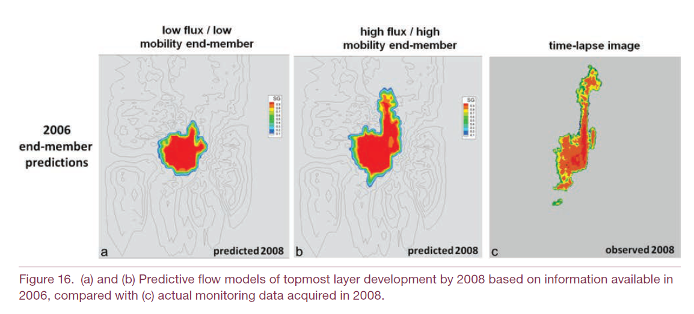
History matching CO₂ plume area (spatial data)
(Literature review)
Seismic data was converted to spatial CO₂ saturation data
Manual history matching!!!

Slide 9
Should we conduct assisted history matching?
Approach: Use ES-MDA to assimilate time-varying spatial CO₂ saturation data (from 4D seismic) into reservoir model
Outcomes: History matched simulated and observed spatial CO₂ saturation data; updated reservoir permeability and porosity fields
How: Use all the gridblock by gridblock saturation data within the plume area? Similar like placing a monitoring well at each gridblock within the plume extent
Challenge: The number of data may be too big for a large scale reservoir with millions of gridblocks. Potential solutions:
use representative point data;
data reduction approach like randomized geostatistical approach (RGA) proposed by Lin et al. (2017).
CO₂ plume
Ground truth

Slide 10
Joint assimilation of spatial data and point data
Available data: time varying spatial CO₂ saturations from seismic survey and point pressures from monitoring
Add point saturation/pressure data into spatial data set for joint assimilation

Slide 11
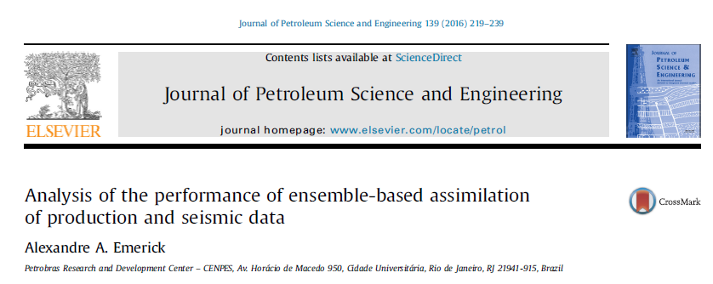
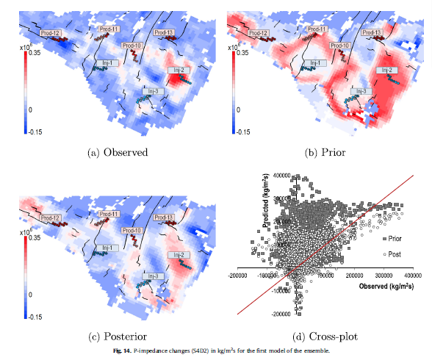
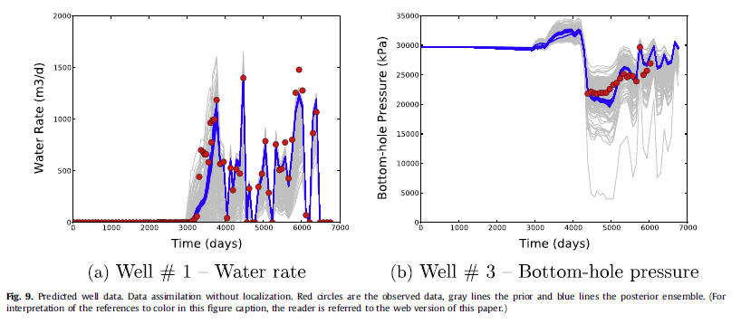
Directly from seismic data
PEM
Seismic data (P-impedance) Reservoir simulation responses

Slide 12
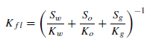
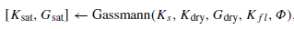
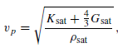
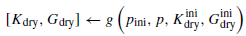
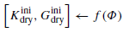
Directly from seismic data
PEM
Seismic data (P-impedance) Reservoir simulation responses
PEM model based on Gassmann equation (1951)
HS: Hashin-Shtrikman
K: bulk modulus
G: shear modulus

Slide 13
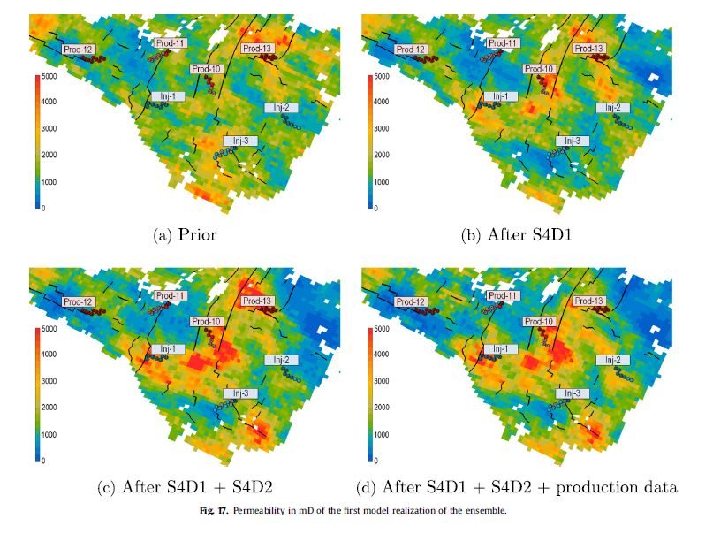
Directly from seismic data

Slide 14
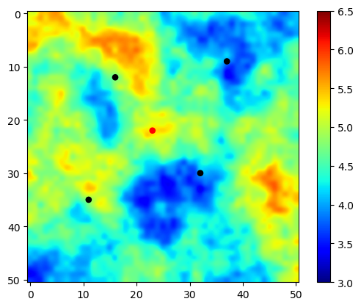
Spatial data assimilation: Case study
Same synthetic example as we used for our previous work
Ground truth

Slide 15
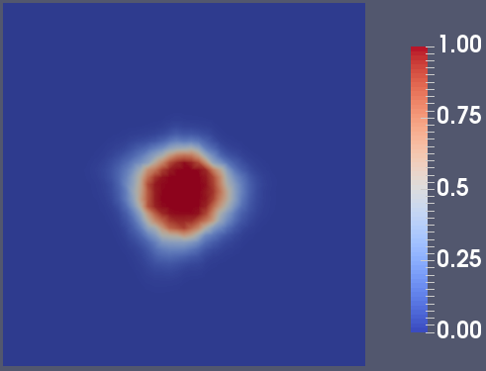
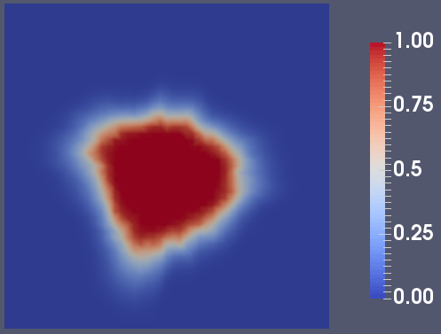
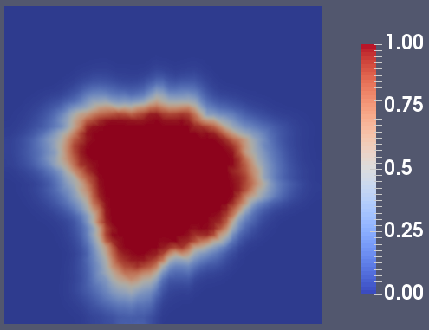
CO₂ saturation maps – 4D Seismic
1 yr
3 yrs
5 yrs
Observational data size: 51*51*1 (2601), 51*51*2, 51*51*3

Slide 16
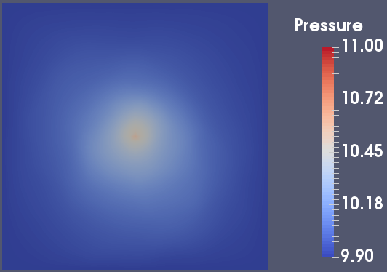
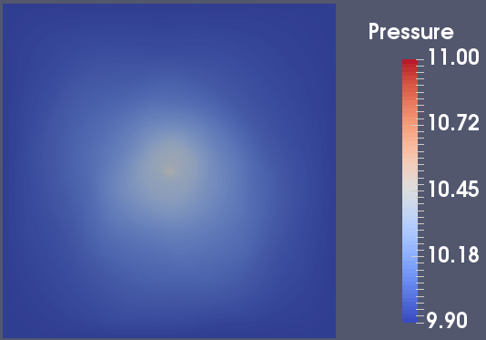

Pressure maps – InSAR
1 yr
3 yrs
5 yrs
Interferometric Synthetic Aperture Radar (InSAR) is an effective way to measure changes in land surface altitude. InSAR makes high-density measurements over large areas by using radar signals from Earth-orbiting satellites to measure changes in land-surface altitude at high degrees of measurement resolution and spatial detail (Galloway and others, 2000).

Slide 17
Plans
Start from only 1 CO2 saturation map, then 2 maps and 3 maps.
Add pressure maps
Add point monitoring data
Compare with our results from point data assimilation: uncertainty in the predictions of pressure/saturation, plume area, model improvement, etc.

Slide 18
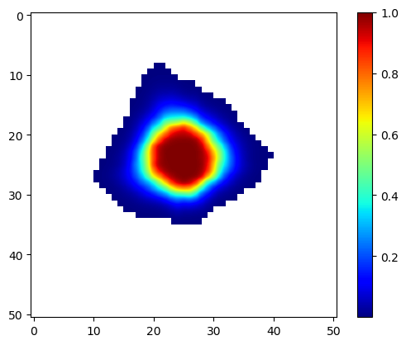
Assimilation of 1-yr saturation map
1 yr

Slide 19
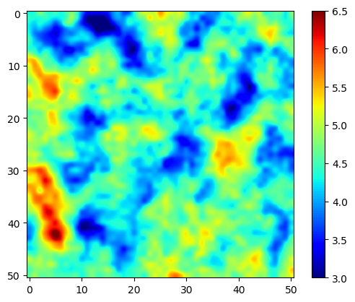
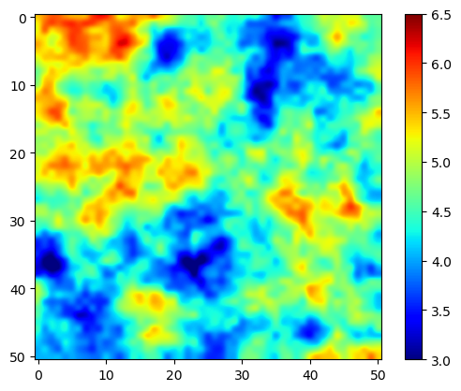
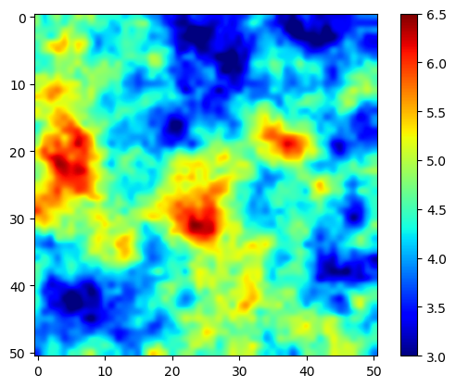
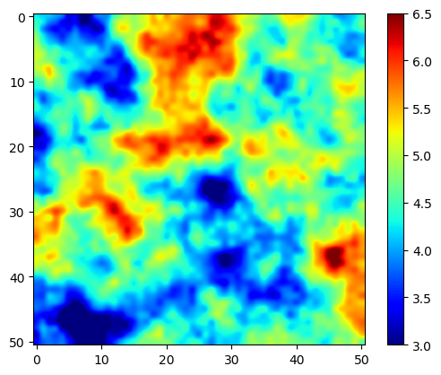
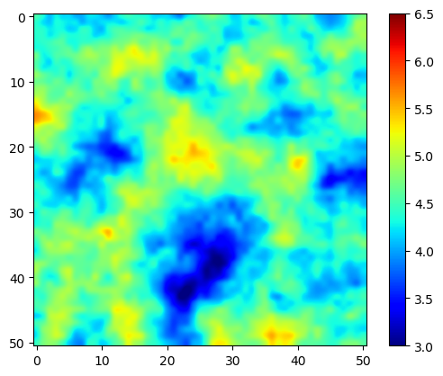
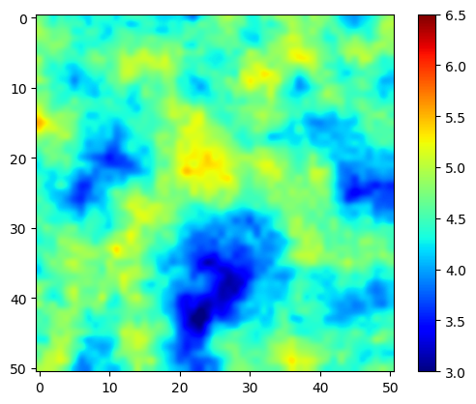
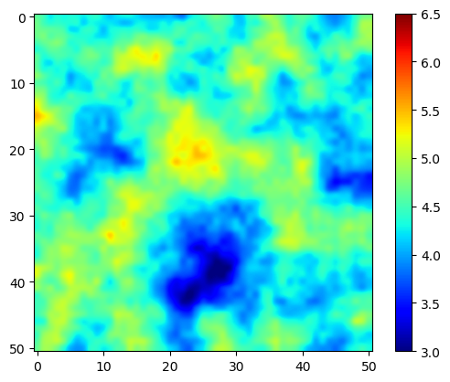
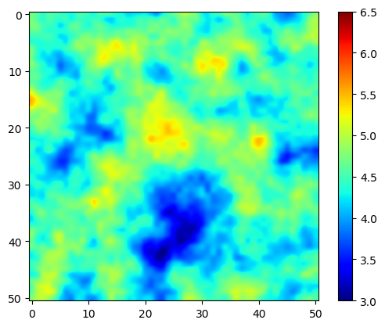

Prior and updated models
R1
R2
R3
R4
Prior
Updated
Ground truth

Slide 20
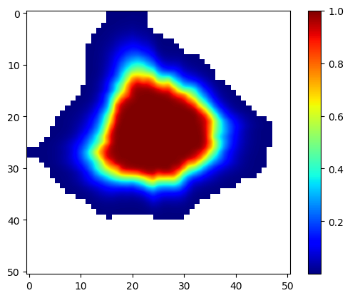
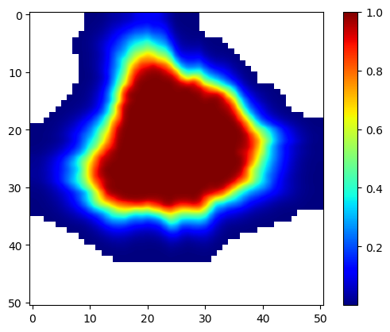
CO₂ saturation maps – 4D Seismic
1 yr
3 yrs
5 yrs

Slide 21
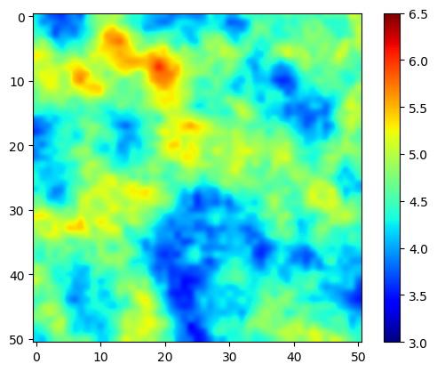
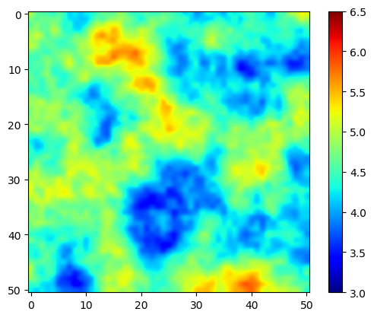
Model updating (R1)
Ground Truth
Prior
1 yr
3 yrs
5 yrs

Slide 22
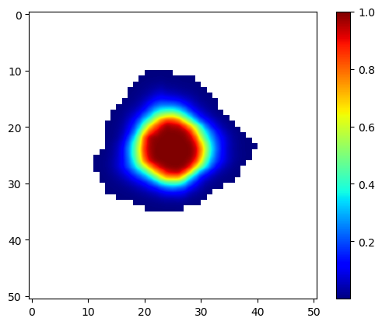
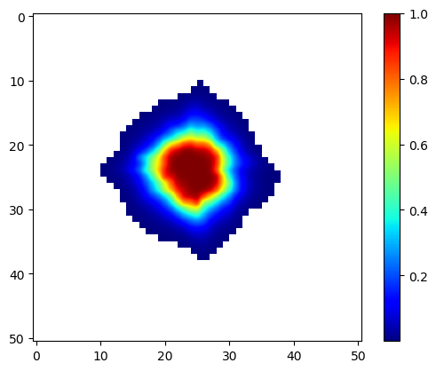
CO₂ saturation plume history matching (1 yr)
Observational CO2 saturation map
History matched CO2 saturation map (R1)
Prior (R1)

Slide 23
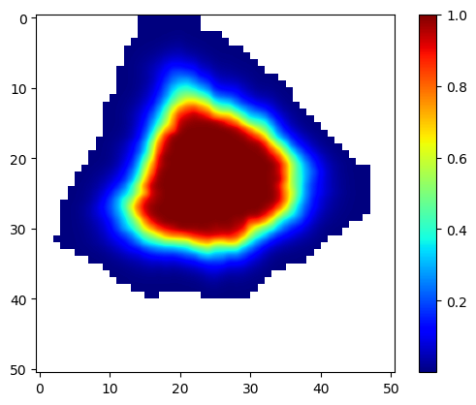
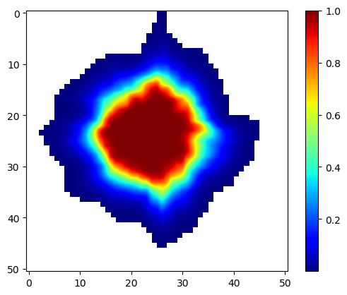
CO₂ saturation plume history matching (3 yrs)
Observational CO2 saturation map
History matched CO2 saturation map (R1)
Prior (R1)

Slide 24
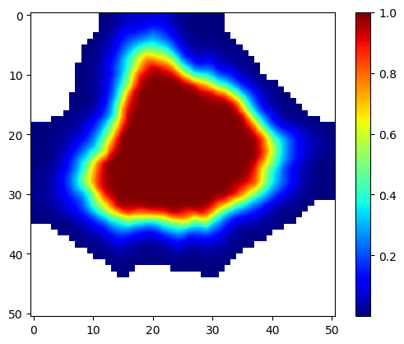
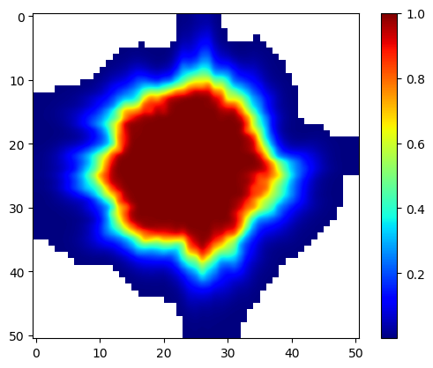
CO₂ saturation plume history matching (5 yrs)
Observational CO2 saturation map
History matched CO2 saturation map (R1)
Prior (R1)

Slide 25
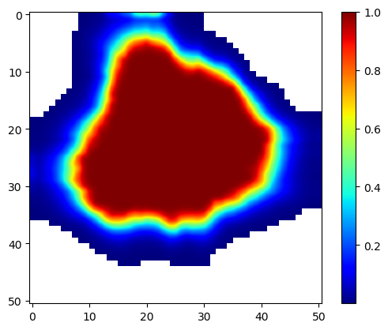
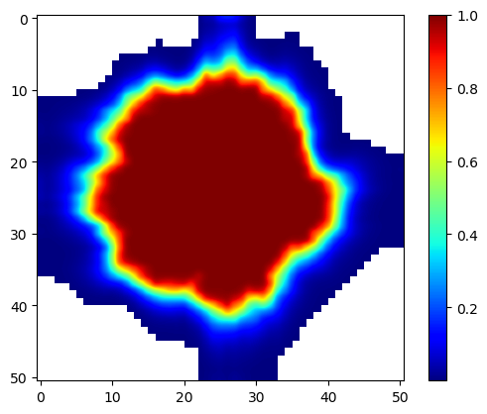
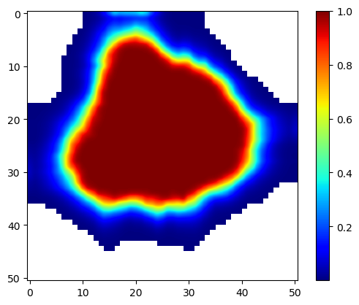
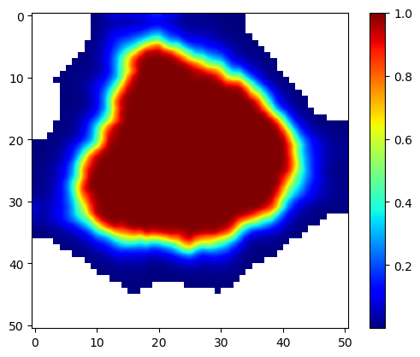
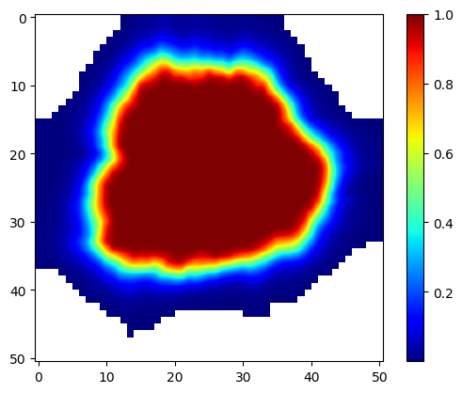
CO₂ saturation plume prediction at 15 yrs (R1)
“True” map
Prior map
5 yrs
3 yrs
1 yr

Slide 26


Pressure map history matching (5 yrs)
Observational pressure buildup map
History matched pressure buildup map (R1)
History match error tolerance: 0.01 MPA

Slide 27




Model updating
R1
R2
R3
R4
Prior
Updated
Not surprising without well matched pressure map!

Slide 28


Next
Assimilation of 1 yr or 1 mth pressure map
Tighten pressure history matching error tolerance: from 0.01 to 0.001 MPa?
Saturation maps: assimilation of time series maps (1 yr + 3 yrs, 1 yr + 3 yrs + 5 yrs)
5 yrs
1 yr
1 mth

Slide 29

Pressure map history matching (1 yr)

Slide 30

Pressure map history matching (1 yr) – tighten HM error tolerance (0.001)
Without tightening
With tightening

Slide 31
Next
Saturation maps: assimilation of time series maps (1 yr + 3 yrs, 1 yr + 3 yrs + 5 yrs)

